Slide 1
DATA SCIENCE DAT10SYD Week 6 - Ensembles

Slide 2
AGENDA
Review of Decision Trees
Ensembling
Bagging
Random Forest
Boosting
Lab
Other Uses
Discussion

Slide 3
DATA SCIENCE PART TIME COURSE
DECISION TREE REVISION

Slide 4
WHAT ARE DECISION TREES?
A supervised learning technique that can be used for classification or regression.
Visually engaging and easy to interpret.
Foundation for getting into very powerful techniques.
Great for explaining to people!

Slide 5
DECISION TREES - SHORTCOMINGS
Prone to overfitting.
Predictive power is lower in comparison to many other modern techniques.

Slide 6
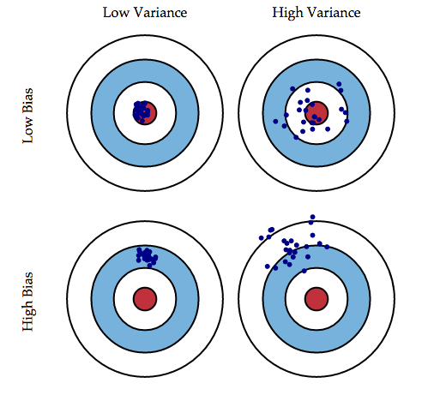
BIAS - VARIANCE TRADEOFF
1￼
Notes:
Checks:
Ask the class to talk in pairs about when there is a tradeoff between simplicity & complexity

Slide 7
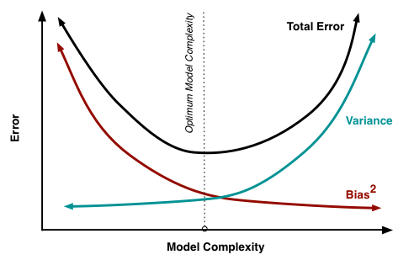
BIAS - VARIANCE TRADEOFF

Slide 8
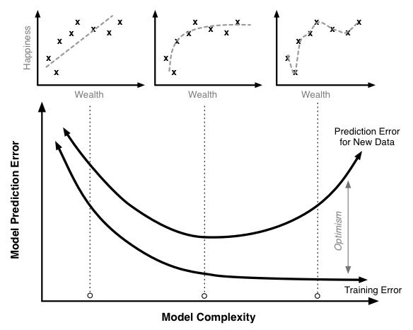
BIAS - VARIANCE TRADEOFF
Notes:
Point out what the two curves represent, then:
Check:
Q: ask one of the students:
Can you explain what this graph is showing?
Q: how do we prevent ending up being mislead about the error?

Slide 9
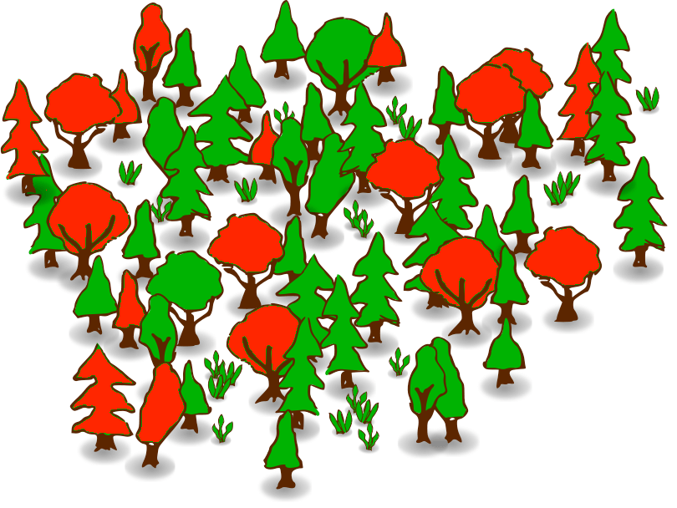
DECISION TREES - ENHANCED
Notes:
v

Slide 10
DATA SCIENCE PART TIME COURSE
ENSEMBLING

Slide 11
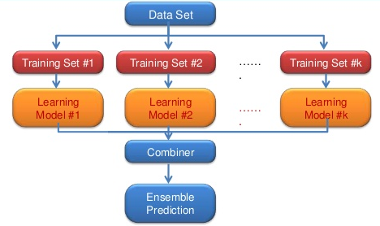
ENSEMBLE MODELS
Notes:
Check: Discussion - In Pairs:
Q: the students have to come up with two ways of combining models
Then ask the class. in turn for their answers.
Claire
Julia
Randeep
Kalaivani
William
Steffi
Sasha
Simon
Kristi
Nicholas
Adam
Geoffrey
Carolyn
Shoaib
Sean
Alvin
Mikaela
Michael
Darren

Slide 12
ENSEMBLE MODELS
Ensemble learning: combines several models to make a prediction.
The combination is more powerful than the sum of the parts.
For classification problems, the combination is done by majority vote.
For regression problems, the combination is done by taking an average of the predictions.

Slide 13
ENSEMBLE MODELS - WHEN DO THEY WORK?
For ensembling to work well, the individual models must meet two conditions:
Models should be accurate (they must outperform random guessing)
Models should be independent (their predictions are not correlated with one another)
Notes:
Check:
Q: what would happen if the models were correlated?
Claire
Julia
Randeep
Kalaivani
William
Steffi
Sasha
Simon
Kristi
Nicholas
Adam
Geoffrey
Carolyn
Shoaib
Sean
Alvin
Mikaela
Michael
Darren

Slide 14
Some examples
You run a journalism / fiction site.
What makes some website content evergreen (always
interesting)?
What makes a house valuable on AirBNB?
When will my mining truck break down?

Slide 15
ENSEMBLE MODELS - STRATEGIES
Typically Packaged Ensemble Methods
Typically Manually Applied Ensemble Methods
Bagging
Boosting
Voting (classification)
Averaging
Rank Averaging
Stacking
Blending
Notes:
Voting - (average vote)
Regression averaging
Classification averaging (average the probabilities) - smooths the decision boundary
Rank Averaging: better
deals with the fact that the scale of the predicted probabilities of each model might be different.
instead use the order (rank)
average the ranks between models and then normalise bw 0 and 1 as a probability
Blending: a combiner model built of other models is built using a small hold out set ~10%
Stacking: like blending but there is a split in the training set with models predicting for a portion of the data they haven’t seen.
Q: what would be the point of a model supplying a prediction for data it has already seen?
Hence issues around information usage / contamination.

Slide 16
DATA SCIENCE PART TIME COURSE
BAGGING

Slide 17

BOOTSTRAP & BAGGING
Bagging is a concatenation of Bootstrapped Aggregation
Bootstrap is a statistical technique used to quantify the uncertainty of a model
Bootstrap samples are random samples from training set with replacement

Slide 18
BAGGING
What is the B+AGG.ing process?
Take repeated bootstrap samples (random samples/rows with replacement) from the training data set
Train on each bootstrapped (randomly sampled) training set and make predictions
Average the predictions

Slide 19



BAGGING
Increases predictive accuracy by reducing the variance
Similar to cross-validation reducing the variance for estimating out-of-sample error by splitting many times and averaging the results.
Notes:
Check:
Q: How could we ensure that we get models with high variance from our decision trees?
Claire
Julia
Randeep
Kalaivani
William
Steffi
Sasha
Simon
Kristi
Nicholas
Adam
Geoffrey
Carolyn
Shoaib
Sean
Alvin
Mikaela
Michael
Darren

Slide 20
Bagging Classifier
import sklearn.ensemble
Bag = sklearn.ensemble.BaggingClassifier(DecisionTreeClassifier(),
n_estimators=5,
max_samples=10,
max_features=2,
n_jobs=-1
)
Bag.fit(DF[[…]], DF.target)
for i in range(len(Bag.estimators_)):
sklearn.tree.export_graphviz(Bag.estimators_[i],
out_file=“filename%d.dot” % i,
features_names=…
)
Ran out of room to fit GridSearchCV on this slide

Slide 21
BAGGED TREES
Grow N regression trees using N bootstrapped training sets
Grow each tree deep enough that each one has low bias
Every tree makes a numeric prediction, and the predictions are averaged (to reduce the variance)
Notes:
What value should be used for B?

Slide 22
Things that bootstrap nicely
Decision Trees
Perceptrons
Ordinary least squares (turns it into Theil-Sen)
Why would it be stupid to bootstrap:
Theil-Sen regressor?
KNearestNeighbours?

Slide 23
DATA SCIENCE PART TIME COURSE
RANDOM FORESTS

Slide 24
RANDOM FORESTS
Notes:
Check:
Q: How might we get diversity in our models
Claire
Julia
Randeep
Kalaivani
William
Steffi
Sasha
Simon
Kristi
Nicholas
Adam
Geoffrey
Carolyn
Shoaib
Sean
Alvin
Mikaela
Michael
Darren

Slide 25
RANDOM FORESTS
Random Forests is a variation of bagged trees
Even better performance!
Here's how it works:
Like bagging, create an ensemble of decision trees using bootstrapped samples of the training set (randomly sampled rows).
When building each tree, each time a split is considered, a random sample of M Features is chosen as split candidates from the full set of P Features. The split is only allowed to use one of those M Features.
Restrict each split to a subset of features
Notes:
see next slide for emphasis on point 2

Slide 26
RANDOM FORESTS
When building each tree,
each time a split is considered,
a random sample of M Features is chosen to measure purity on
from the full set of P Features.
The split is only allowed to use one of those M Features.
Notes:
Draw a decision tree growing.
Check:
Q: How many predictors should we choose?
Claire
Julia
Randeep
Kalaivani
William
Steffi
Sasha
Simon
Kristi
Nicholas
Adam
Geoffrey
Carolyn
Shoaib
Sean
Alvin
Mikaela
Michael
Darren

Slide 27


RANDOM FORESTS
A new random sample of predictors is chosen for every single tree at every single split.
For classification, M is typically chosen to be the square root of P.
For regression, M is typically chosen to be somewhere between P/3 and P.

Slide 28
RANDOM FORESTS
What's the point?
Suppose there is one very strong predictor in the data set. When using bagged trees, most of the trees will use that predictor as the top split, resulting in an ensemble of similar trees that are "highly correlated".
Averaging highly correlated quantities does not significantly reduce variance (which is the entire goal of bagging).
By randomly leaving out candidate predictors from each split, Random Forests "decorrelates" the trees, such that the averaging process can reduce the variance of the resulting model.

Slide 29
VARIABLE IMPORTANCE
Although bagging increases predictive accuracy, it decreases model interpretability because it's no longer possible to visualize the tree to understand the importance of each variable.
To compute variable importance for bagged regression trees, we can calculate the total amount that the mean squared error is decreased due to splits over a given predictor, averaged over all trees.
A similar process is used for bagged classification trees, except we use the Gini index instead of the mean squared error.
Notes:
Check:
Q:
Claire
Julia
Randeep
Kalaivani
William
Steffi
Sasha
Simon
Kristi
Nicholas
Adam
Geoffrey
Carolyn
Shoaib
Sean
Alvin
Mikaela
Michael
Darren

Slide 30
OUT-OF-BAG ERROR
Bagged models have a very nice property: out-of-sample error can be estimated without using the test set approach or cross-validation. How it works:
On average, each bagged tree uses about two-thirds of the observations. For each tree, the remaining observations are called "out-of-bag" observations.
For the first observation in the training data, predict its response using only the trees in which that observation was out-of-bag. Average those predictions (for regression) or take a majority vote (for classification).
Repeat this process for every observation in the training data.
Compare all predictions to the actual responses in order to compute a mean squared error or classification error. This is known as the out-of-bag error.
Notes:
Ask them to guide in the process that I am drawing. - how to choose.
Break Down.
Discussion
Draw a 10 record table of records, with 4 variables.
Use colours for 3 different bags.
Draw 3 new tables of records.
Claire
Julia
Randeep
Kalaivani
William
Steffi
Sasha
Simon
Kristi
Nicholas
Adam
Geoffrey
Carolyn
Shoaib
Sean
Alvin
Mikaela
Michael
Darren

Slide 31
RandomForestRegressor / RandomForestClassifier
Rfr = sklearn.ensemble.RandomForestRegressor(n_jobs=-1,
n_estimators=20)
… etc

Slide 32
DATA SCIENCE PART TIME COURSE
BOOSTING

Slide 33
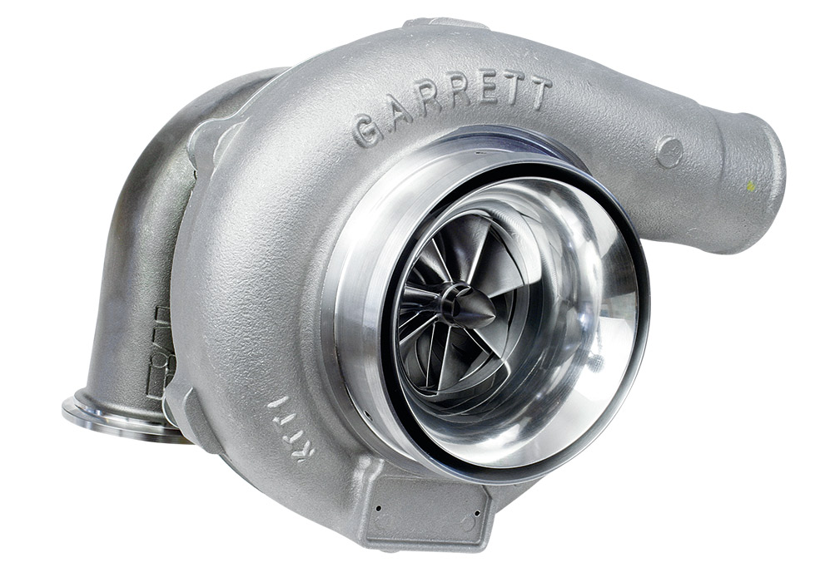
BOOSTING
Boosting involves the base learners being built sequentially (using previous models). The aim is to reduce the bias of the combined estimator.
Compare this to something like bagging where the models are built independently of one and other.

Slide 34
ADABOOST - ADAPTIVE BOOSTING
AdaBoost works by building sequential models on re-weighted versions of the data. Initially all data points have the same weighting = 1/N.
After the first model the error on the points is evaluated and the weighting for each observation is adjusted. So if we fit a model and an observation has a large difference between the observed and predicted we give that observation a higher weighting and run the model again.
This means observations that are difficult to predict become more influential in the model.

Slide 35
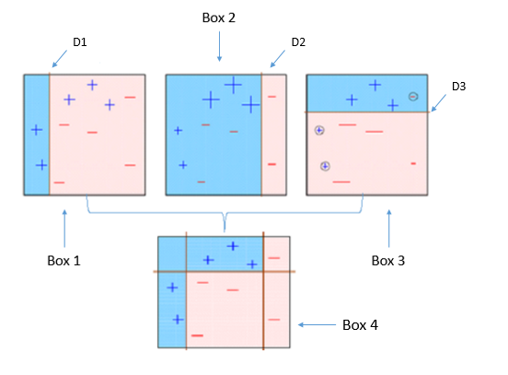
ADABOOST - ADAPTIVE BOOSTING
Accentuating the training labels for each sequential model.
See how box 2 (model 2) has the labels accentuated.
The simple models are combined for the final model.

Slide 36
GRADIENT BOOSTING
Gradient Boosting is a technique that are sequentially fitted that minimise a loss function. For regression this might be the square loss. So we would be updating the model based on Gradient Descent.
This differs to AdaBoost where the boosting was performed by re-weighting the original observations.

Slide 37
eXtreme Gradient Boosting - (regularised gradient boosting)
XGBoost is an optimised distributed gradient boosting library designed to be highly efficient, flexible and portable.
It implements machine learning algorithms under the Gradient Boosting framework.
XGBoost provides a parallel tree boosting(also known as GBDT, GBM) that solve many data science problems in a fast and accurate way.
The same code runs on major distributed environment(Hadoop, SGE, MPI) and can solve problems beyond billions of examples.
- https://github.com/dmlc/xgboost

Slide 38
DATA SCIENCE PART TIME COURSE
OTHER USES

Slide 39
RANDOM FOREST FOR CLUSTERING
The idea is to create Synthetic data (fake data that is based on the original data set)
Then combine this fake data with your original data set
Assign a ‘Synthetic_data’ with 1 for the synthetic data and 0 for real data
Run the Random Forest model trying to predict ‘Synthetic_data’
You will have a ‘distance metric’ or ‘proximity’ which is basically how many times the samples occur in the same terminal nodes.

Slide 40
RULEFIT = RANDOM FOREST + ELASTIC NET
Extract all the rules from all the trees and use them as features in an elastic net model.
Nice way to build a simpler more interpretable model

Slide 41
sklearn.ensemble.*
AdaBoostClassifier | AdaBoostRegressor
BaggingClassifier | BaggingRegressor
GradientBoostingClassifier | GradientBoostingRegressor
RandomForestClassifier | RandomForestRegressor

Slide 42
What do you need to remember from tonight?
Random Forests are awesome.
Everyone knows them.
You can get a long way with a Random Forest
Gradient Boosting is amazingly effective
Competes with deep learning for accuracy
Rulefit
You will make millions from this over the next few years
Explainable + quite good accuracy

Slide 43
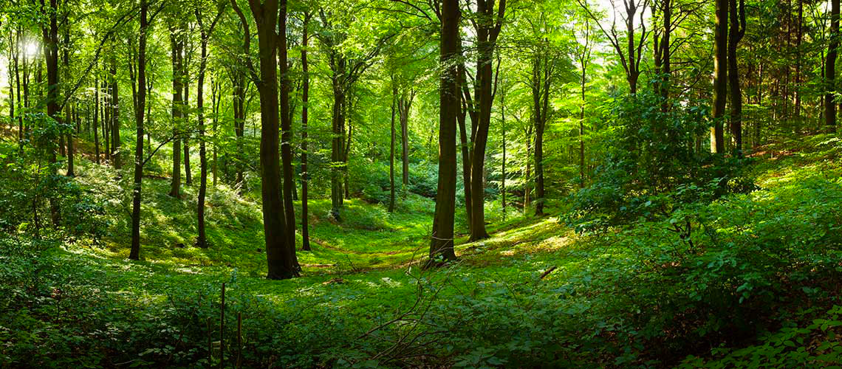
DATA SCIENCE PART TIME COURSE
LAB

Slide 44

SYNCHING YOUR FORK WITH THE COURSE REPO
re-name your labs with lab_name.<yourname>.ipynb (to prevent a conflict)
cd <path to the root of your DAT10SYD local repo>
commit your changes ahead of sync
git status
git add .
git commit -m “descriptive label for the commit”
git status
download new material from official course repo (upstream) and merge it
git checkout master (ensures you are in the master branch)
git fetch upstream
git merge upstream/master

Slide 45
DATA SCIENCE
HOMEWORK Homework Complete Project 3 for Tues 9th Jan 2018 Read the following Chapter 8.2 of Introduction to Statistical Learning - Bagging, Random Forests, Boosting

Slide 46
WEEK 4 - Review
FINAL PROJECT
Complete Project 1 for Tues 12th Dec 2017
Complete Project 2 for Tues 19th Dec 2017
Complete Project 3 for Tues 9th Jan 2018 <= NEXT UP
Complete Project 4 for Tues 16th Jan 2018
Complete Project 5 for Tues 23th Jan 2018
Deliver Final Project Tues 30th Jan 2018

